Slide 1
UWEcyber

Slide 2
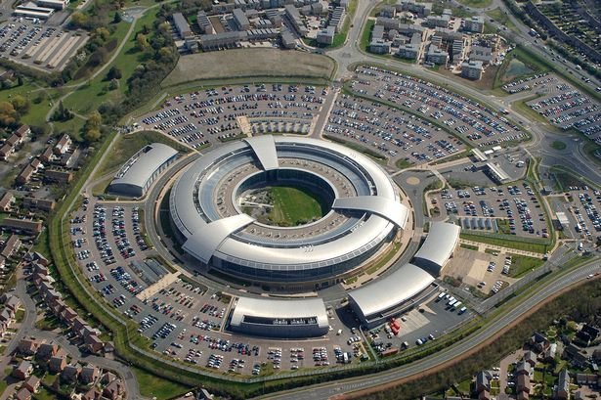

UWEcyber
UWEcyber was recognised by National Cyber Security Centre (NCSC) as one of the first Academic Centres of Excellence in Cyber Security Education (ACE-CSE) in December 2020, for our commitment to teaching, research, outreach and external industry engagement.
Our MSc Cyber Security has been NCSC-certified since it started in 2018.
Our Degree Apprenticeship with Gloucestershire College is the only NCSC-certified programme in England and Wales.
Our undergraduate programme is to be submitted for certification in 2024 following module redesign.

Slide 3
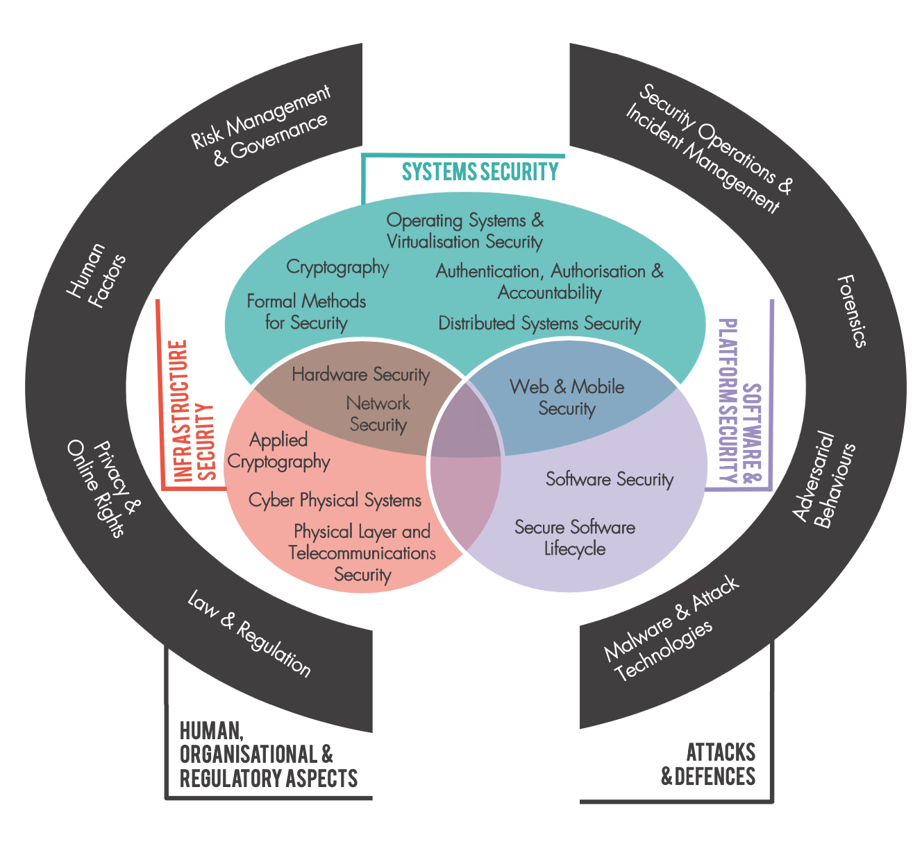
CyBOK
NCSC Framework for what constitutes a Cyber Security Body of Knowledge.
Recent recognition of two new supplementary guides:
Security and Privacy of AI
AI for Security
All activity within our theme sits within one or more CyBOK Knowledge Areas.

Slide 4
UWEcyber Research Strategy
Software, Cloud and Infrastructure Security
Container-based, Software Security, IoT, CAV, Hardware
Cyber Security Data Analytics
ML for Security, Security of ML, Explainable AI, Privacy, Transparency and Trust
Cyber Crime and Domestic Cyber Security
Online Harms, Forensic Analysis, Dark Web, Financial Crime
Pedagogical Research for Cyber Security
Effective interactive methods for teaching and learning

Slide 5


























Slide 6
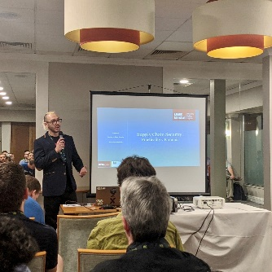
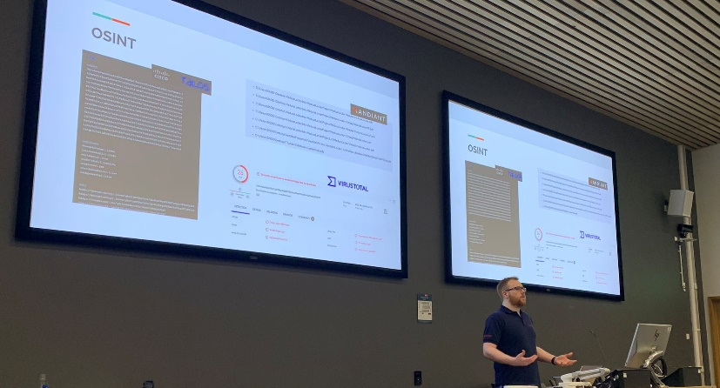
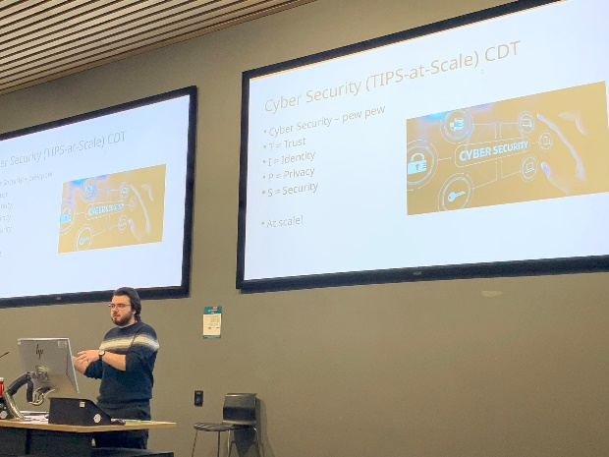
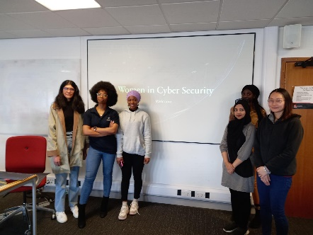
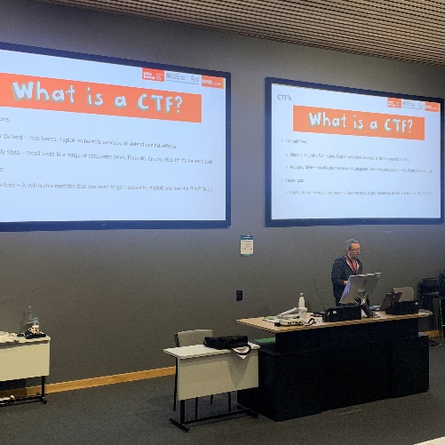
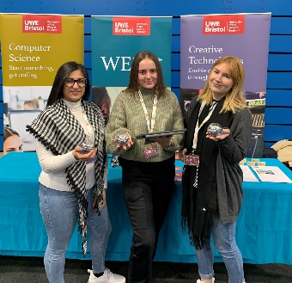
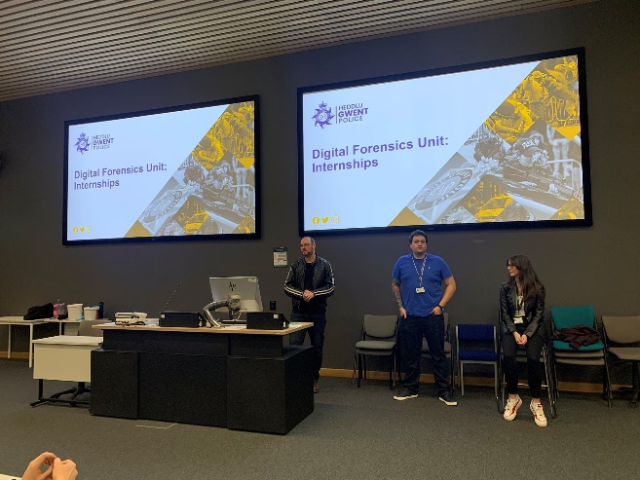
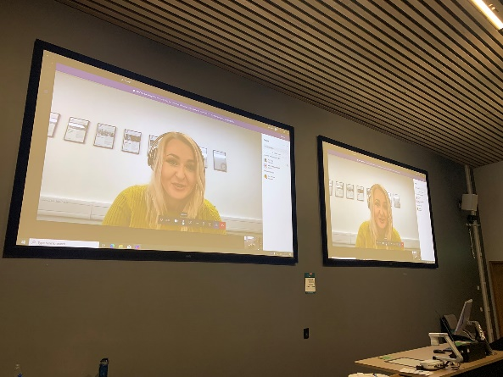
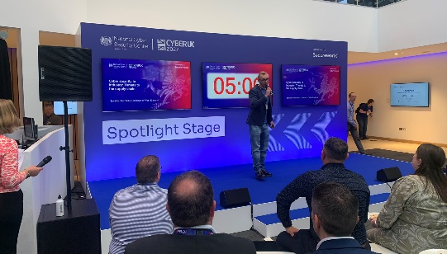
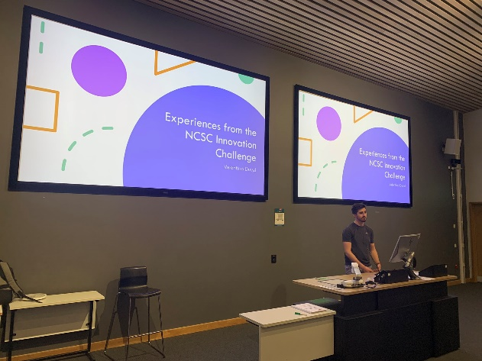
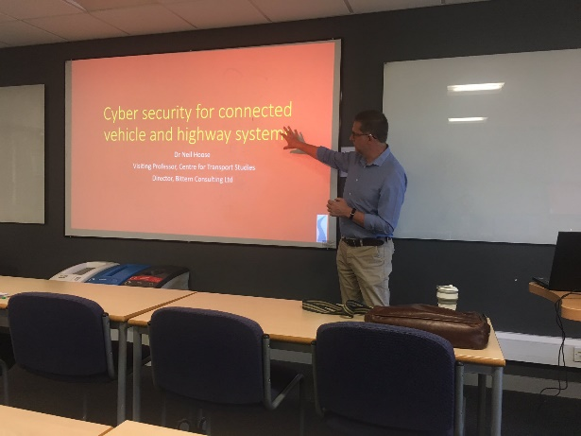
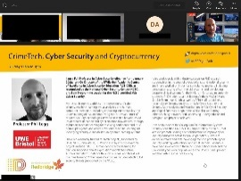
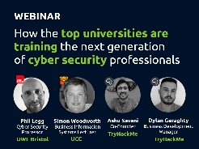

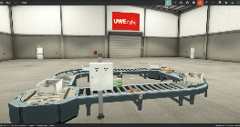
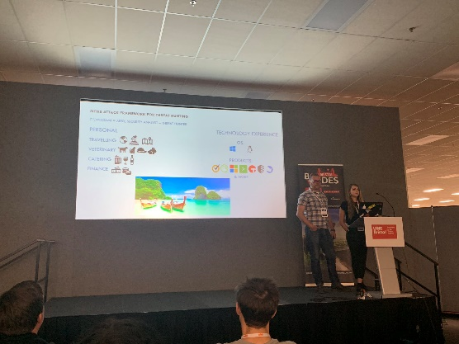
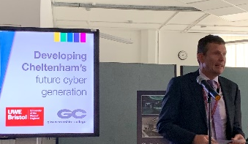
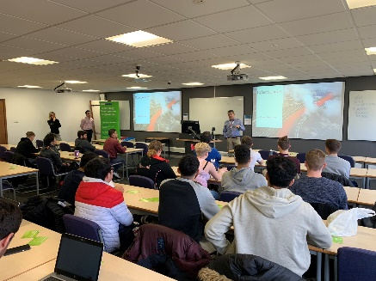
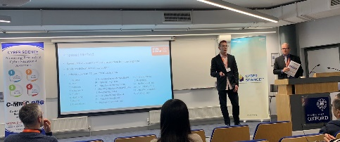
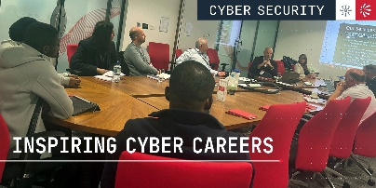
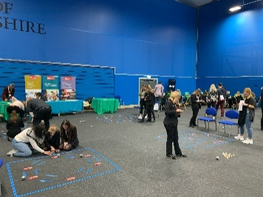
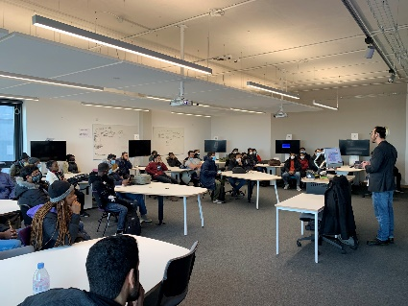
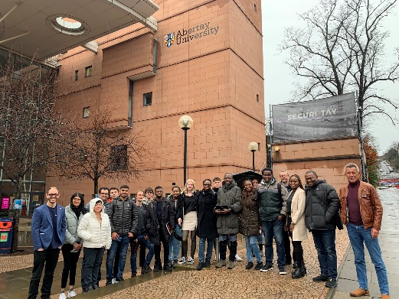
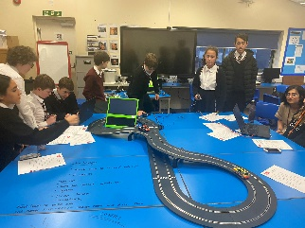
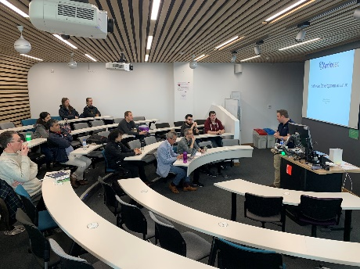

Slide 7
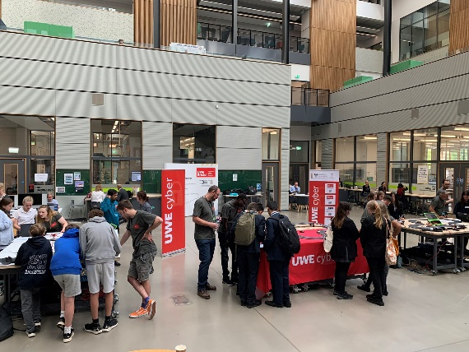
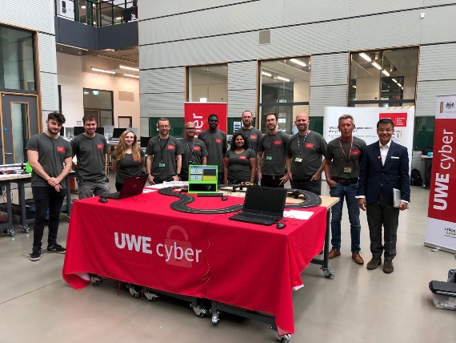





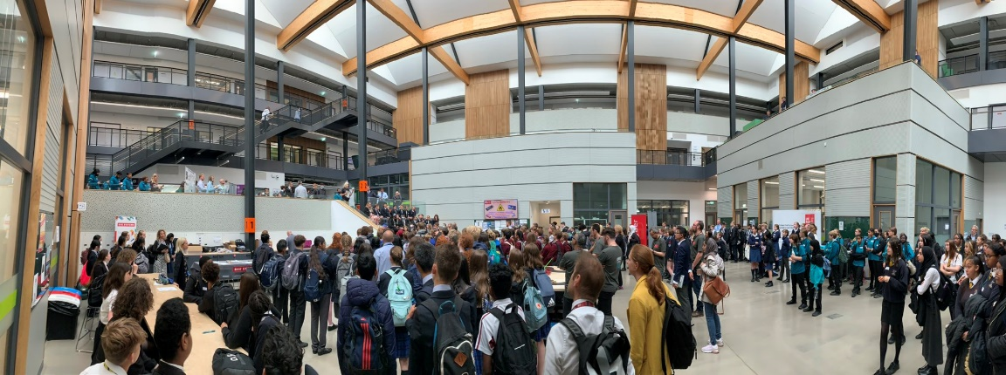






Cyber Security Education Outreach

Slide 8
Staff Profiles and Research

Slide 9














Research Staff Members

Slide 10
Cyber Threat Intelligence in Industry 4.0
Current research: Cyber Threat Intelligence in Distributed Environments
PhD supervision: Digital Twins-based Advanced Persistent Threats in Smart Manufacturing Environments
PhD candidate: Ms. Carol Lok Yi Lo
Publications
C.Lo, TY.Win, Z.Rezaeifar, Z.Khan, P.Legg, 2023, “Digital Twins in Industry 4.0 Cyber Security”. Submitted to the IEEE Smart World Congress 2023, Portsmouth, United Kingdom.
Dr Thomas Win
Thomas.Win@uwe.ac.uk

Slide 11
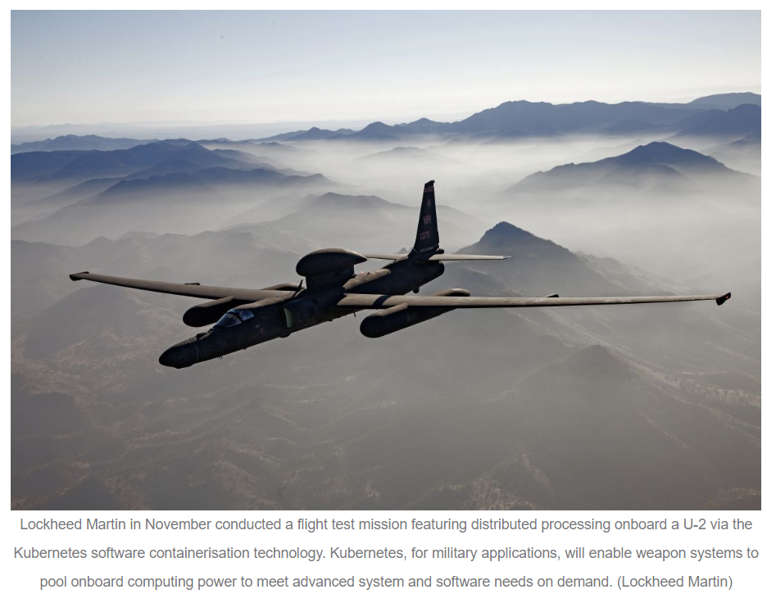
Low Resource Virtualisation Security
What does that mean?
Containerisation and similar virtualisation tech
Why is it important?
Because of their real world usage ->
What am I doing?
Focus on real world security
Vulnerability analysis in Computers and Security
Visualisation software in IEEE CSR
Alan Mills
Alan.Mills@uwe.ac.uk
https://www.janes.com/defence-news/news-detail/lockheed-martin-conducts-u-2-flight-with-kubernetes-software-containerisation-technology

Slide 12





CySec and DFIR Research
Gareth Davies
Senior Academic & Researcher
Forensics Consultant
First Forensic Forum (F3) Chairman
UK Digital Forensics Specialist Group
Criminal Justice Board (Digital Evidence)
Interpol DF & Car Cyber Threat Expert Group
Interests include:
Recent Research Output:
Digital Investigator Journal:
‘Defining User Requirements and Technical Specifications to Assist with Effective Validation of Digital Forensics methods.’
in conjunction with UK Government (FCN) and Kings College London.
19th International Conference on Cyber Warfare and Security (ICCWS 2024):‘A.I. Lifecycle Forensics’, ‘Who Controls The Future of A.I.?’(CySec perspective) & ‘Resilience, Dependability and Security’ (CySec skills shortage)
HDD Physical and Logical Restoration
Embedded Device Data Recovery
NAND Flash Technology
Cars (JDM mostly)
Vehicle Systems Analysis
Fundraising for Charity (Mountains / Hiking)
Gareth Davies
Gareth13.Davies@uwe.ac.uk

Slide 13
Protection in Armed conflicts: Security for vulnerable data
Area of research: protection of personal data in a digital form during armed conflicts – case study Ukraine.
Main aim: to investigate public attitudes towards cyberattacks in relation to privacy and data security through engaging with those Ukrainians who: who: 1) live in Ukraine, 2) are temporarily living in the UK, and 3) are permanently settled in the UK but have family connections in Ukraine.
Impact: To develop and disseminate an evidence-based human-centric framework on cybersecurity and data protection during armed conflict.
Dr Aida Abzhaparova
Aida2.Abzhaparova@uwe.ac.uk

Slide 14
Research Topics
Internet of Things (IoT) and Cyber Security
Advanced Machine Learning and IoT/Smart City applications
Mobile and Wireless Networks
Distributed Systems and Network Security
Smart builds and smart transportation
Publications:
https://scholar.google.com/citations?user=B0rtByAAAAAJ&hl=en
Dr Djamel Djenouri
Djamel.Djenouri@uwe.ac.uk

Slide 15
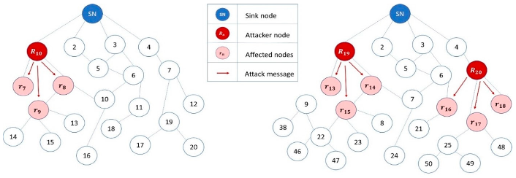
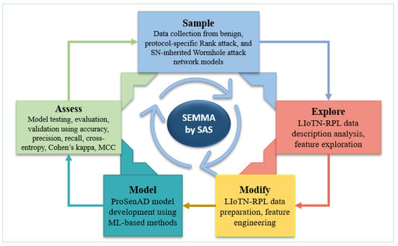
Cyber Attacks Detection and Mitigation Approaches in Smart City Technologies (Cloud and IoT)
My research focuses on cloud and IoT security in smart cities and recently I have been working on Routing Protocol for Low-power and Lossy Networks (RPL).
For networks with limited resources, such as IoT-enabled smart homes, smart industrial equipment, and urban infrastructures, the Routing Protocol for Low-power and Lossy Networks (RPL) was developed.
The lack of active security features in RPL makes them vulnerable to attacks. The types of attacks include protocol-specific ones and those inherited by wireless sensor networks.
In our latest research we developed a security approach to improve the security against PS-R attacks as well as SN-W attacks. Our model is developed based on multiclass classification approaches and it effectively detects attacks sensor inherited RPL attacks in comparison to the related research contributions.
My upcoming research focuses more on developing cloud security approaches for smart cities to protect data-in-motion.
Dr Sarfraz Brohi
Sarfraz.Brohi@uwe.ac.uk
Recent publication: Zahra, F.; Jhanjhi, N.Z.; Khan, N.A.; Brohi, S.N.; Masud, M.; Aljahdali, S. Protocol-Specific and Sensor Network-Inherited Attack Detection in IoT Using Machine Learning. Appl. Sci. 2022, 12, 11598. https://doi.org/10.3390/app122211598

Slide 16
Cyber Security Research
PhD students’ projects
Graph-based group anomaly detection in IoT with deep learning : in this project, we look at graph-based method that leverage deep learning approaches to detect group anomaly ( PhD student: Dalila Khettaf Supervisors: Djamel Djenouri and Zeinab Rezaeifar)
Design a Secure Digital Twin to Detect and Mitigate Advanced Persistent Threats on Cyber-Physical Systems in Smart Manufacturing: in this project, we are exploring a secure method based on Digital Twin to detect and mitigate Advanced Persistent Threats ( APTs). ( PhD student: Lok Yi Lo (Carol) Supervisors: Thomas Win, Phil Legg, Zaheer Khan, and Zeinab Rezaeifar)
BTIIC-Situation Awareness
It is a part of BT Ireland Innovation Centre (BTIIC) project which is funded by Invest Northern Ireland and representing major partnership between BT and Ulster University. The aim of the Situation Awareness project is to reconstruct and detect multi-step attack scenarios (APT attacks) through automated correlation of alert data. ( April 2020-Present)(RA: Zeinab Rezaeifar (BT Ireland Innovation Centre (ulster.ac.uk))
Dr Zeinab Rezaeifar
Zeinab.Rezaeifar@uwe.ac.uk

Slide 17
Research Interests
Network-based Anomaly Detection
Federated Learning
Container Security
Collaborative machine learning, training a shared model without exchanging private data
Tools & techniques to secure infrastructure, images, & runtime environment of Docker
Identifying abnormal network traffic indicating malware or unauthorised access
Application of FL to cyber security domain
Security of FL mechanisms
Visualisation of threats
Analysis of threats over time
Detection and remediation of Home IoT threats
White, J. and Legg, P. (2023a). Federated Learning: Data Privacy and Cyber Security in Edge-Based Machine Learning. In Data Protection in a Post-Pandemic Society: Laws, Regulations, Best Practices and Recent Solutions (pp. 169-193). Cham: Springer International Publishing.
White, J. and Legg, P. (2023b) Evaluating Data Distribution Strategies in Federated Learning: A Trade-off Analysis between Privacy and Performance for IoT Security. 9th International Conference on Cyber Security, Privacy in Communication Networks (ICCS) 2023 (Under Review)
White, J., & Legg, P. (2021). Unsupervised one-class learning for anomaly detection on home IoT network devices. In 2021 International Conference on Cyber Situational Awareness (CyberSA).
Jonathan White
Jonathan6.White@uwe.ac.uk ​

Slide 18


Cyber Research
Dr. Andrew McCarthy – Senior Lecturer
Research Interests
Methods for improving Robustness against adversarial Machine learning Attacks.
Evasion attacks on Intrusion Detection Systems
Secure and Safer Machine Learning Models
Supported Decision Making
Research outputs
Functionality-Preserving Adversarial Machine Learning for Robust Classification in Cybersecurity and Intrusion Detection Domains: A Survey
A McCarthy, E Ghadafi, P Andriotis, P Legg
Journal of Cybersecurity and Privacy 2 (1), 154-190
Feature Vulnerability and Robustness Assessment against Adversarial Machine Learning Attacks
A McCarthy, P Andriotis, E Ghadafi, P Legg
2021 International Conference on Cyber Situational Awareness, Data Analytics …
GRAIMATTER Green Paper: Recommendations for disclosure control of trained Machine Learning (ML) models from Trusted Research Environments (TREs)
E Jefferson, J Liley, M Malone, S Reel, A Crespi-Boixader, X Kerasidou, ...
Shouting Through Letterboxes: A study on attack susceptibility of voice assistants
A Mccarthy, BR Gaster, P Legg
2020 International Conference on Cyber Security and Protection of Digital …
Defending against adversarial machine learning attacks using hierarchical learning: A case study on network traffic attack classification
A McCarthy, E Ghadafi, P Andriotis, P Legg
Journal of Information Security and Applications 72, 103398
Safe machine learning model release from Trusted Research Environments: The AI-SDC package
J Smith, R Preen, A McCarthy, AC Boixander, J Liley, S Rogers
Dr Andrew McCarthy
Andrew6.McCarthy@uwe.ac.uk ​

Slide 19



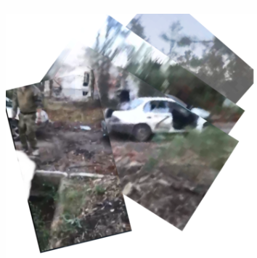
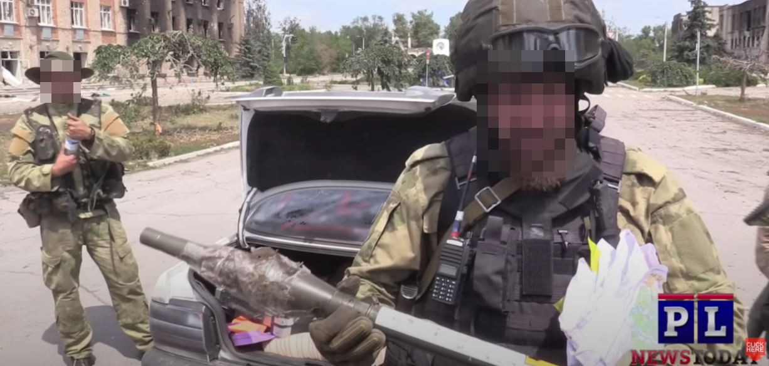
Cyber Forensic Research
Jay Murphy – Programme leader and Senior Lecturer
BSc – Cyber Security and Digital Forensics.
Developing research interests
Dynamic crime scene triage, Dark web(DW) Investigations and mobile device forensics.
Research output
Social Media and Dark Web analysis for Digital Investigations: Contextualising Dark Web Investigations (House, Murphy, Legg – In progress/2023)
DPhil - 2024
Lifting the Fog of War: Preserving Digital Fingerprints on the modern battlefield
This project aims to confront the challenges and add to the body of knowledge of digital forensic practices conducted on the modern battlefield, specifically to identify, preserve, maintain and leverage evidence that will be used in the prosecution of war crimes committed during armed conflicts.
Team, B.I. (2022) Tracking the Faceless Killers who Mutilated and Executed a Ukrainian POW bellingcat. 5 August 2022 [online]. Available from: https://www.bellingcat.com/news/2022/08/05/tracking-the-faceless-killers-who-mutilated-and-executed-a-ukrainian-pow/ [Accessed 29 October 2023].
(Bellingcat, 2022)
Jay Murphy
Jay.Murphy@uwe.ac.uk ​

Slide 20
A secure routing approach based on league championship algorithm for wireless body sensor networks in healthcare.
This research work introduced a secure routing approach for wireless body sensor networks in healthcare, aiming to balance energy efficiency and security. The approach employs the league championship algorithm for cluster head selection and utilizes both symmetric and asymmetric encryption for intra-cluster and inter-cluster secure connections. Simulation results demonstrate its efficiency in terms of energy consumption, delay, throughput, packet delivery rate, and packet loss rate.
Hosseinzadeh, M., Mohammed, A. H., Rahmani, A. M., A Alenizi, F., Zandavi, S. M., Yousefpoor, E., …Tightiz, L. (2023). A secure routing approach based on league championship algorithm for wireless body sensor networks in healthcare. PLoS ONE, 18(10), Article e0290119. https://doi.org/10.1371/journal.pone.0290119. Available from https://uwe-repository.worktribe.com/output/11149364
Dr Mazhar Malik
Mazhar.Malik@uwe.ac.uk ​

Slide 21
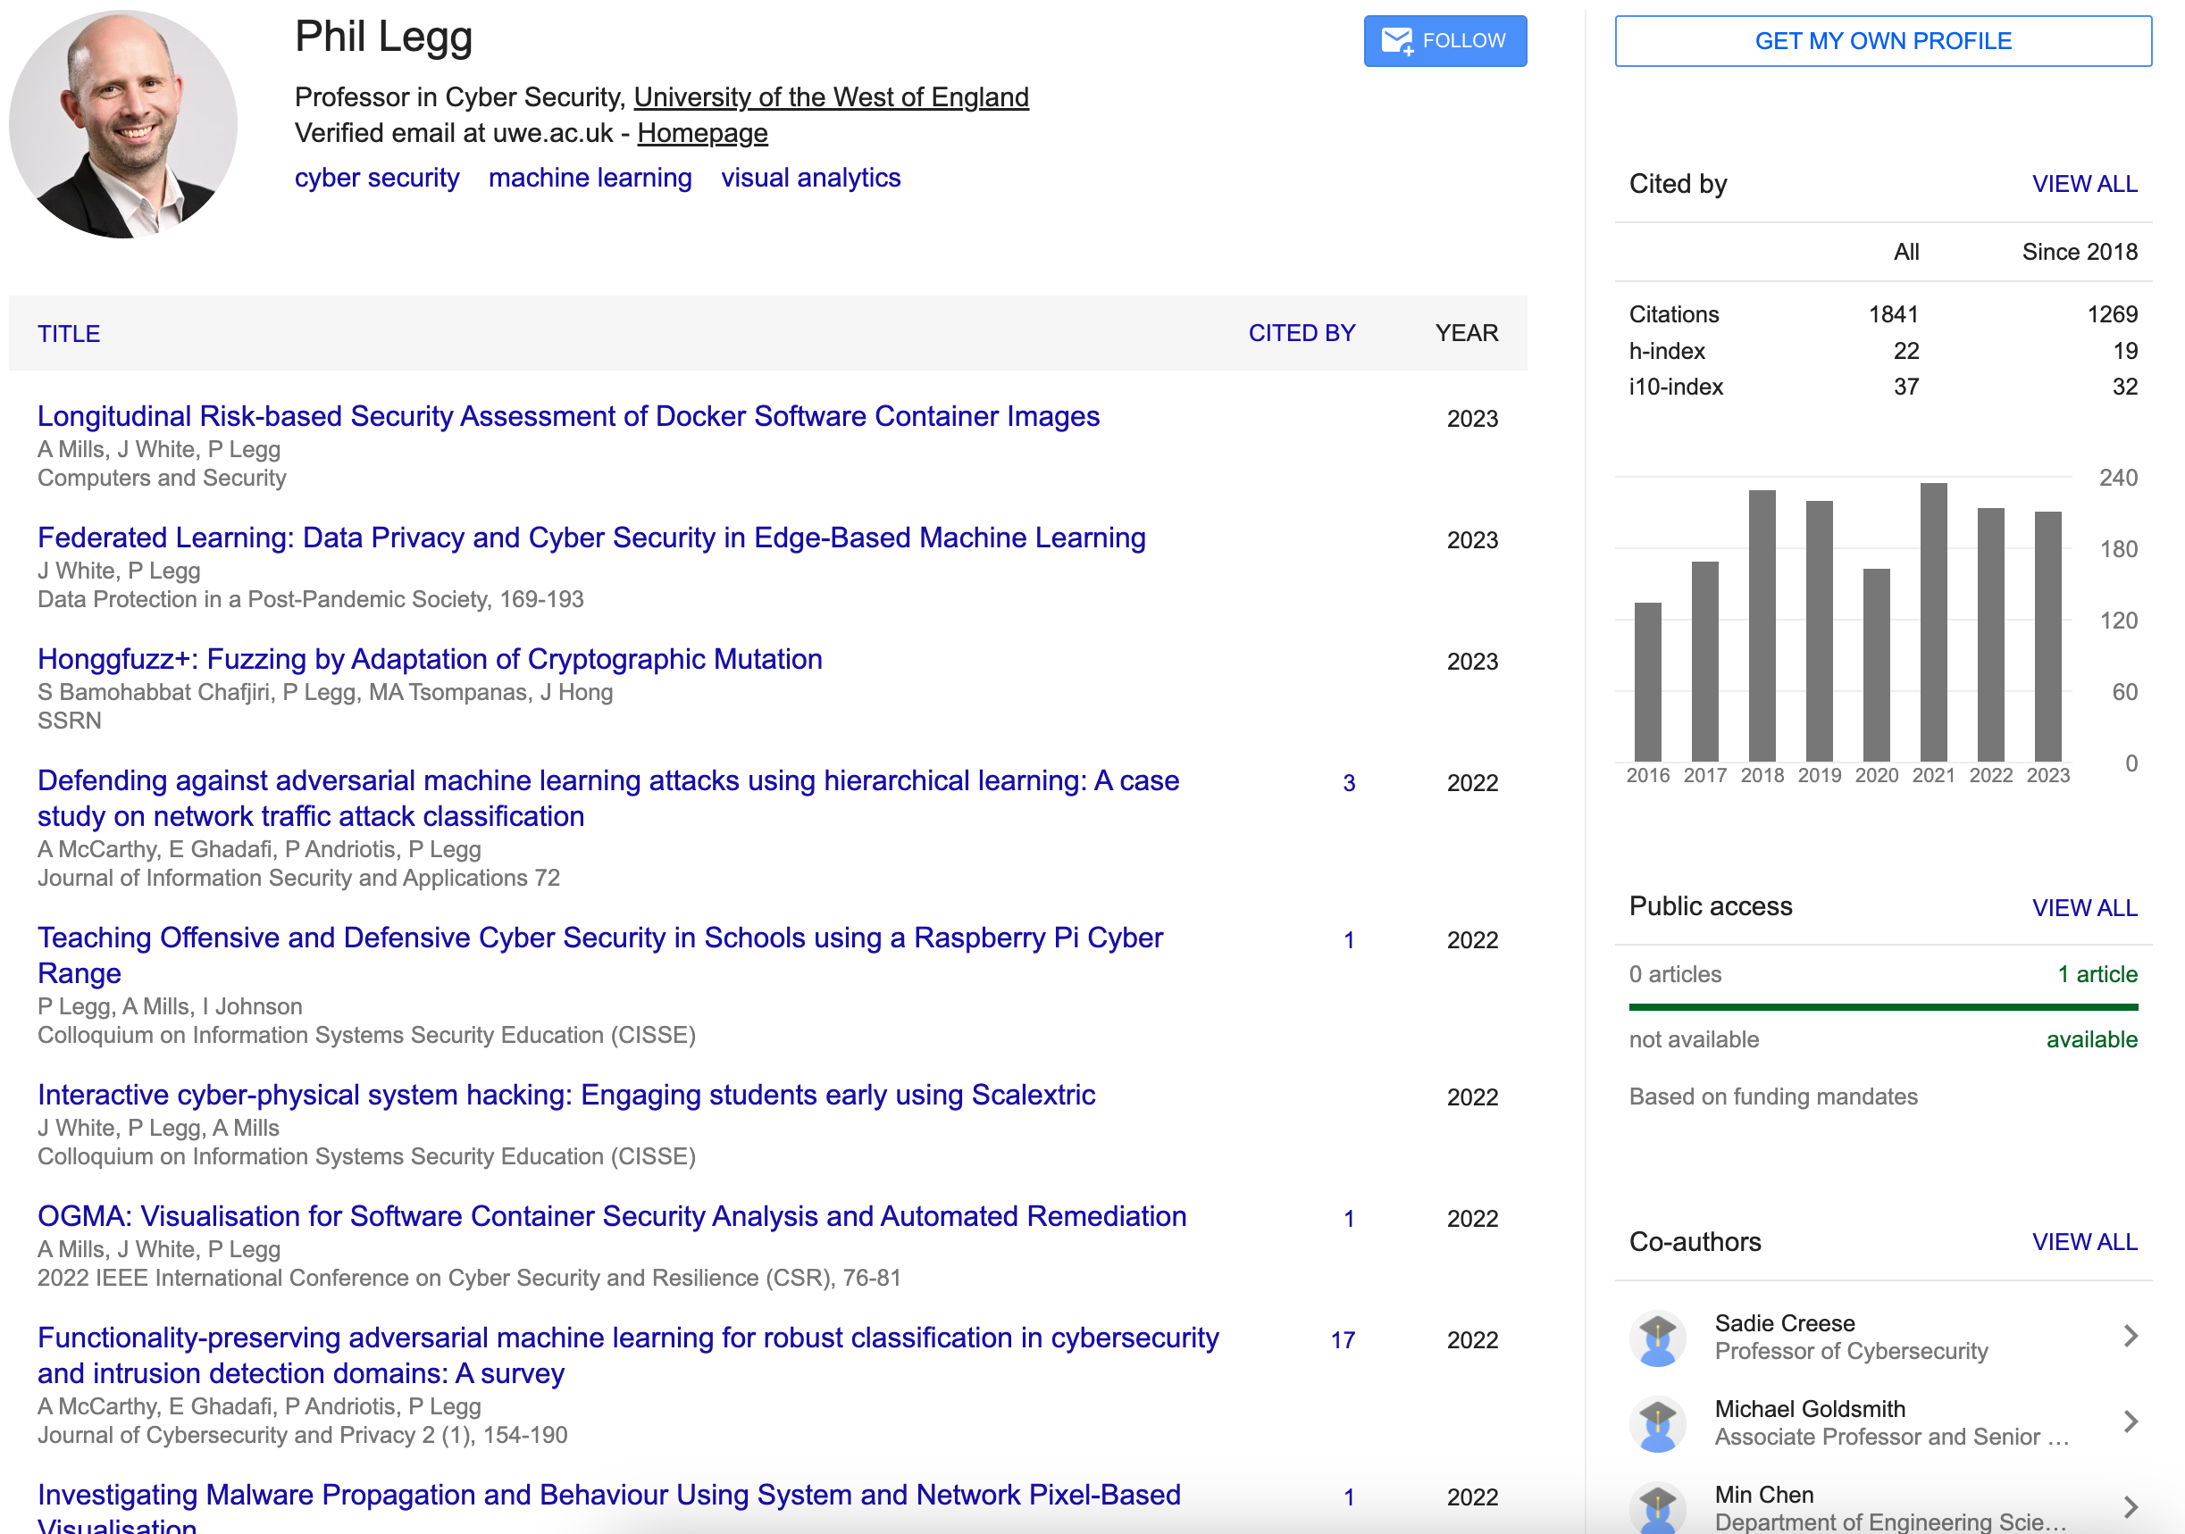
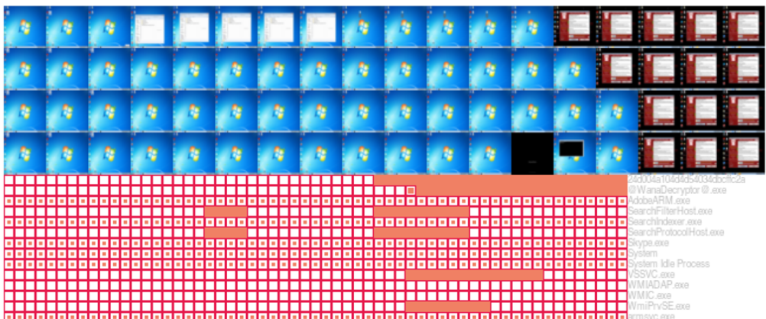
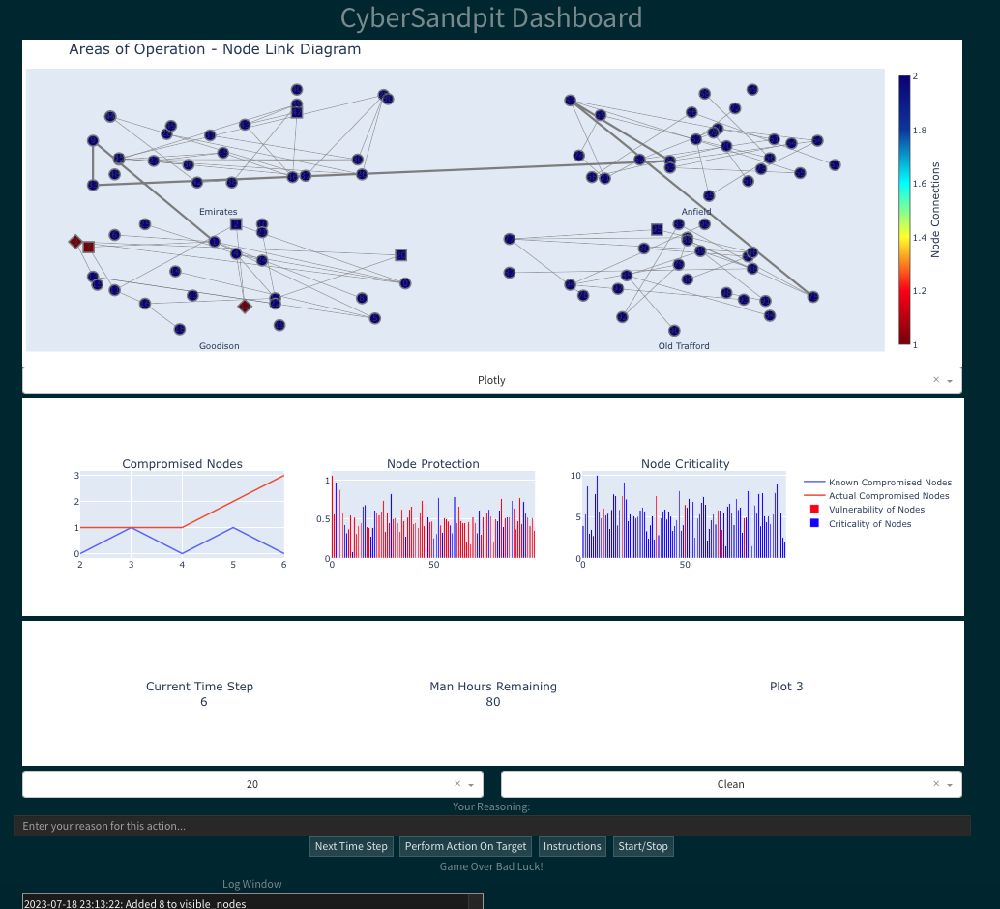
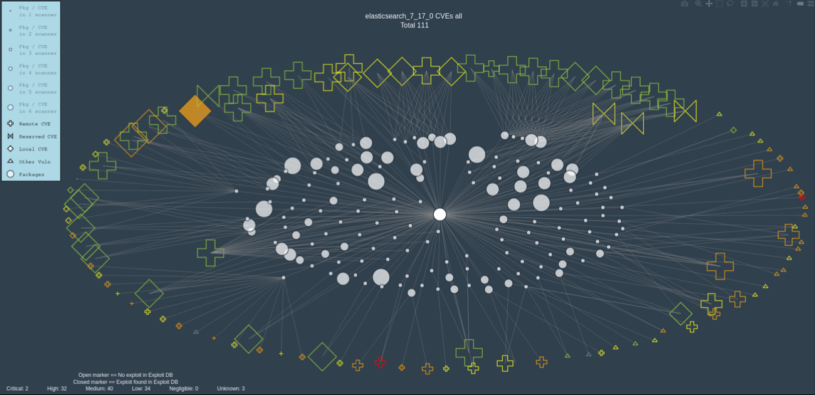
Cyber Security Data Analytics
Data Visualisation
Cyber Security
How to make effective real-time decisions to manage Cyber Security challenges and threats, informed by both human and machine operators?
Recent Funded projects:
InnovateUK - Transforming Suspicious Activity Reports
DSTL - Decision Support in Military Cyber Operations
DSTL - Human-as-a-Sensor for Mitigating Cyber Threats
DSTL - Autonomous Resilience for Cyber Defence
Machine Learning
Find my Publications on Google Scholar
Professor Phil Legg
Phil.Legg@uwe.ac.uk ​

Slide 22
PhD Students

Slide 23


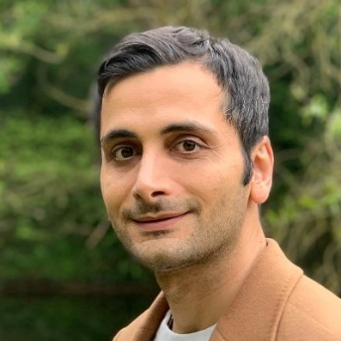

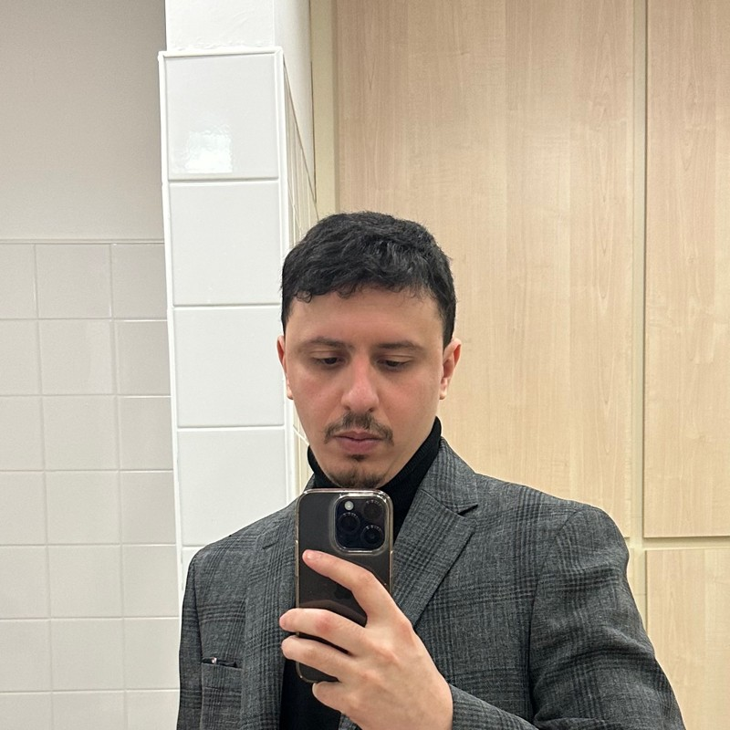
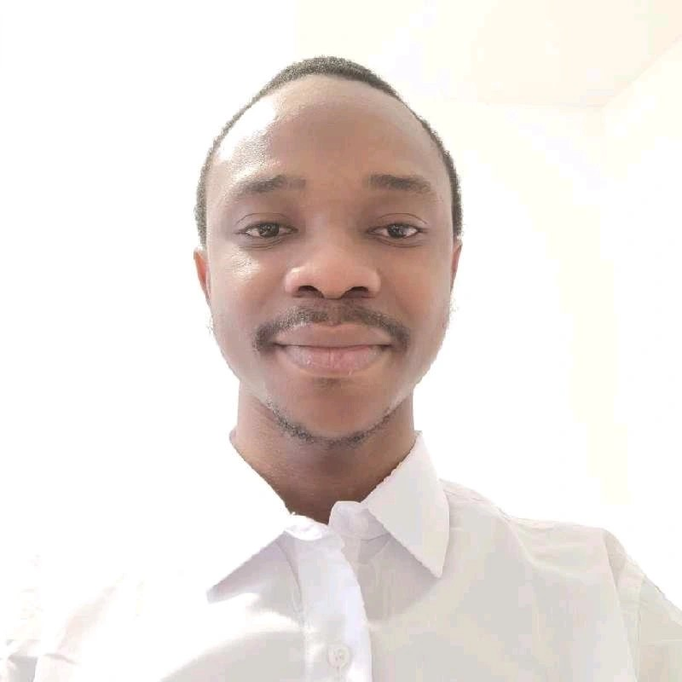
PhD Students

Slide 24
Carol Lo
PhD: Design of a secure digital twin to detect and mitigate advanced persistent threats on cyber-physical systems in Smart Manufacturing

Slide 25
James Barrett
PhD: Interactive machine learning for identifying threats to security and service in large-scale mobile networks

Slide 26
Sadegh Bamohabbat Chafjiri
PhD: Fuzzing by adapting cryptanalytic techniques and game theory

Slide 27
Dalila Khettaf
PhD: Graph-based group anomaly detection in IoT with Deep Learning

Slide 28
Aimen Djemaa
PhD: Adversarial Machine Learning Attacks on Federated Learning Models

Slide 29
Yunus Karrem
PhD: Securing IoT Systems using emerging blockchain variants, decentralised identity and proof of location

